Slide 1
Engineering of Mobile Systems Student: Ridvan Plluzhina
Grocery Mate App

Slide 2
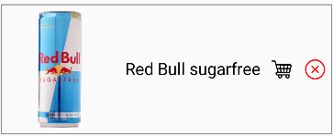
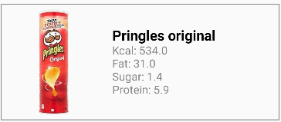
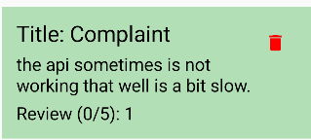
Introduction
Purpose:
An app to help users manage groceries, favorite items, and product reviews.
Main Features:
- View products.
- Add to cart.
- Mark items as favorite.
- Check nutrition details
- Leave reviews.

Slide 3
App Architecture
• High-Level Components:
- ViewModel for state management.
- Room for local database.
- Retrofit for network communication.
- Jetpack Compose for UI.
• Interaction:
- ViewModel manages app state and interacts with Room and Retrofit.
- Compose handles UI updates.

Slide 4

Features
• Navigation:
- Navigate between product categories, cart, favorites, and reviews.
• Data Fetching:
- Fetch product data from OpenFoodFacts API.
• Local Storage:
- Add reviews and save to Room database.
• User Interaction:
- Add/remove items to/from cart and favorites.

Slide 5
Data Handling
• Room Database:
- Used to store reviews locally.
- Products in Cart,Favorite and Counter screens.
• Retrofit API:
- Fetch product details from OpenFoodFacts API.
- Efficient state management with ViewModel.

Slide 6
Challenges and Solutions
• Challenges:
- Room database integration.
- Retrofit API handling and error management.
• Solutions:
- Followed documentation and best practices.
- Debugged and tested thoroughly.

Slide 7
Conclusion
• Grocery Mate App simplifies grocery management.
• Features:
- Product browsing, cart management, reviews, and favorites.
- Combines Room, Retrofit, ViewModel, and Compose effectively.

